Slide 1
Introduction to Statistics for Ecology and Evolutionary Biology Model Selection Week 09 25 March 2019

Slide 2
Introduction to Statistics for Ecology and Evolutionary Biology Model Selection Week 09 25 March 2019

Slide 3
Introduction to Statistics for Ecology and Evolutionary Biology The Dangers of Overfitting, Model Comparison, “How Do I Choose What Goes Into My Model?”, and Some Other Related Stuff Week 09 25 March 2019

Slide 4
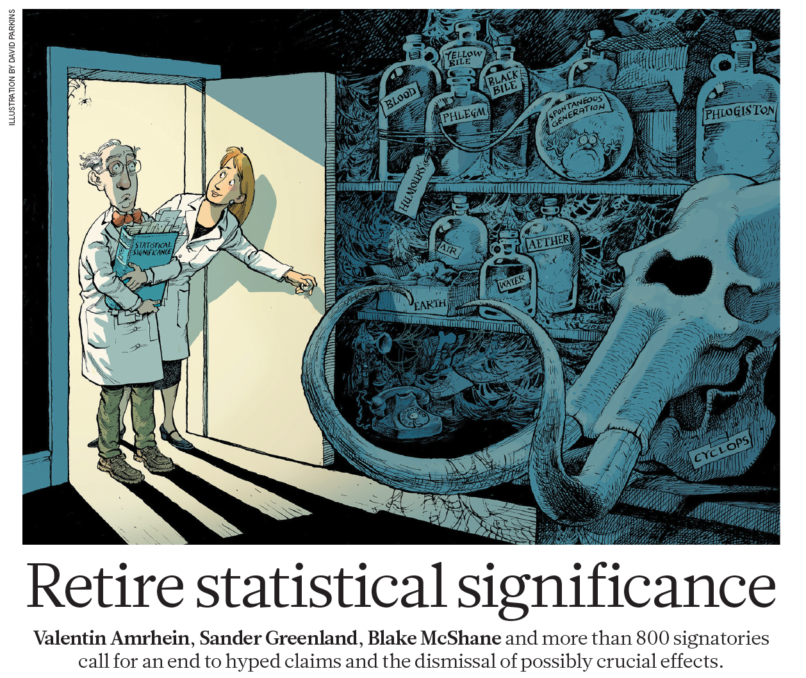
Statistical Norms: Open for Debate
Amrhein et al. 2019, Nature

Slide 5
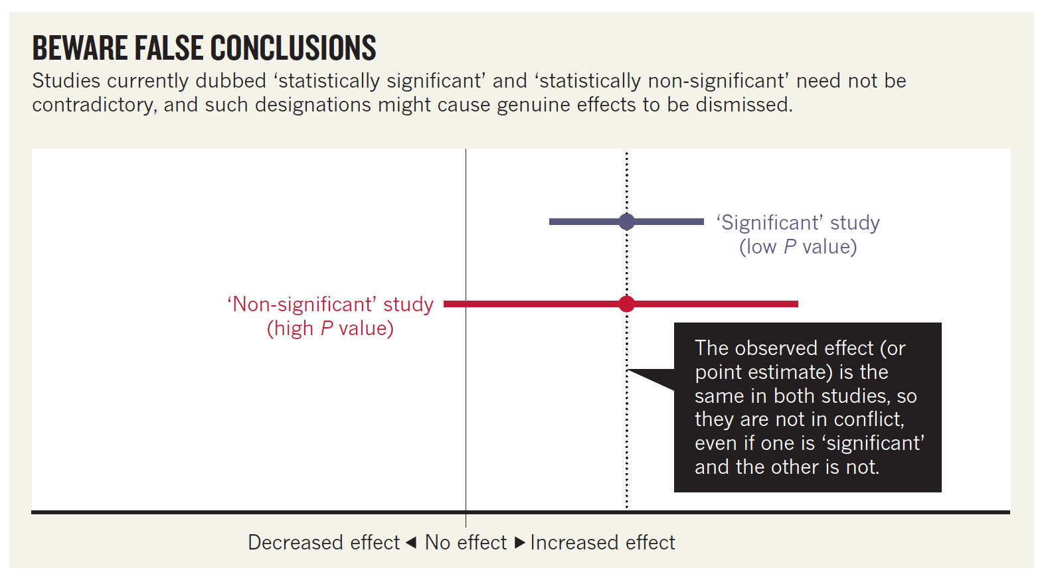
Statistical Norms: Open for Debate
Amrhein et al. 2019, Nature
Notes:
Note that this article encourages careful interpretation of parameter estimates (i.e., point estimates or effect sizes) rather than dichotomization into significant and non-significant results

Slide 6
A Statistical Balancing Act
Notes:
Model comparison approaches are often (explicitly) seeking to balance different model properties
https://www.gardenlines.co.uk/shop/play-equipment/garden-games-wooden-seesaw

Slide 7
Complexity in Ecology
“Ecology would be easy, were it not for all the ecosystems—vastly complex and variable as they are … Scientists like to impose structure and order on chaos, and ecologists are no different. Ecology has its grand theories, but they are riddled with conditional clauses, caveats and exceptions … It is doubtful that the generalities that underlie the complex patterns of nature will ever be phrased succinctly enough to fit on a T-shirt.”
Editorial 13 March 2014, Nature

Slide 8
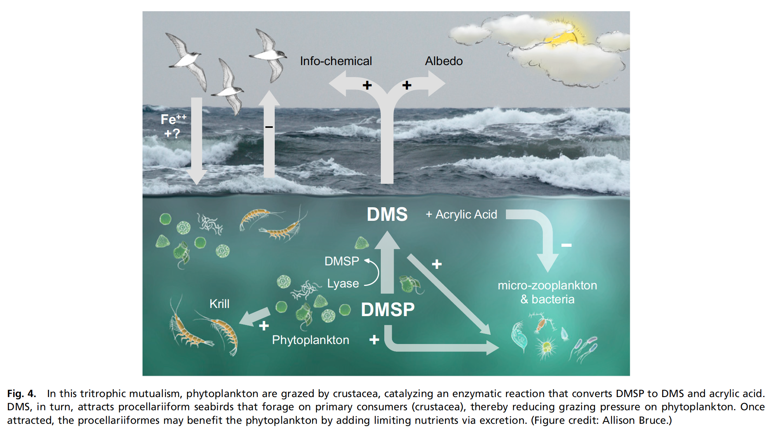
Complexity in Ecology
Savoca and Nevitt 2014, PNAS
Notes:
Complexity is a real property of ecological systems, and one we as ecologists and evolutionary biologists are trained to look for
This results in challenging problems in formulating and choosing among competing models

Slide 9
(The Problem with) Ockham’s Razor
Ockham’s razor is a heuristic stating that simpler theories are to be preferred to more complex ones
This would imply we might choose simpler models
However, models differ not only in complexity but also accuracy, and ideally we want to balance these competing model characteristics
Notes:
William of Ockham was a medieval philosopher
Note, this is “razor” in the philosophical sense of a simplifying principle
https://www.britannica.com/topic/Occams-razor/media/424706/194403

Slide 10
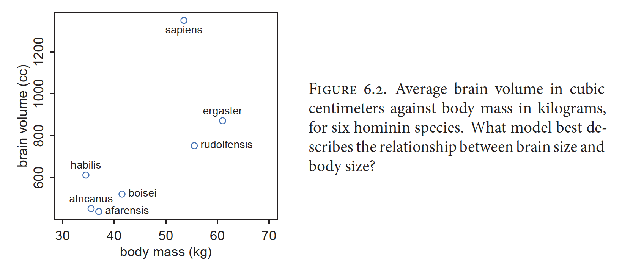
The Problem with (Too Many) Parameters
McElreath 2016, Statistical Rethinking
Notes:
A strategy to illustrate the problem with parameters is to fit this same dataset with increasingly complex models

Slide 11
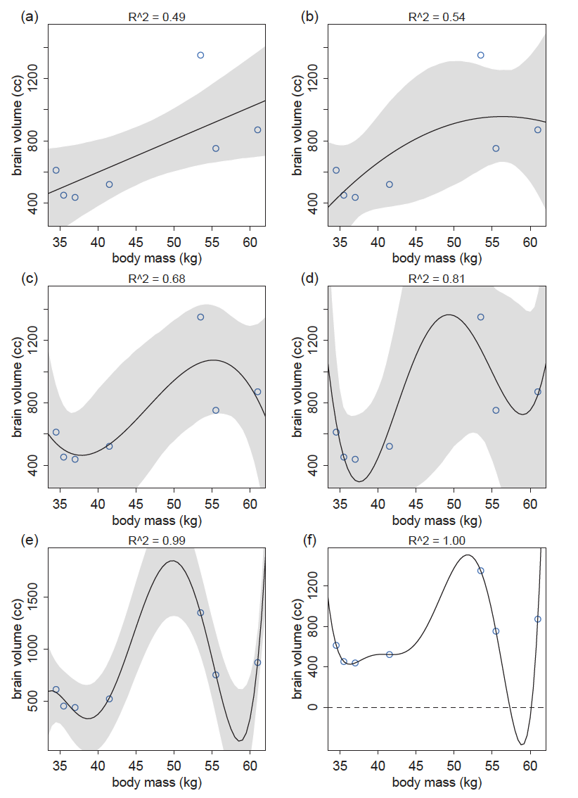
Notes:
R^2 is used here as a measure of model fit to the observed data
Note the model in the lower right corner has a perfect fit to the observed data, but the predictions (i.e., negative values) are clearly problematic
This is a primary problem with parameters: overfitting
“Overfitting occurs when a model learns too much from a sample.”

Slide 12
The Problem with (Too Many) Parameters
If predictor variables suffer from multicollinearity then adding parameters can hurt overall inference (as we saw in the last lecture)
Moreover, adding parameters nearly always improves the fit of the model to the observed data
And yet more complex models often fit new data worse
In other words, they do not perform well out-of-sample
Notes:
Major point: out-of-sample prediction is usually (at least implicitly) what we actually care about in evaluating models

Slide 13
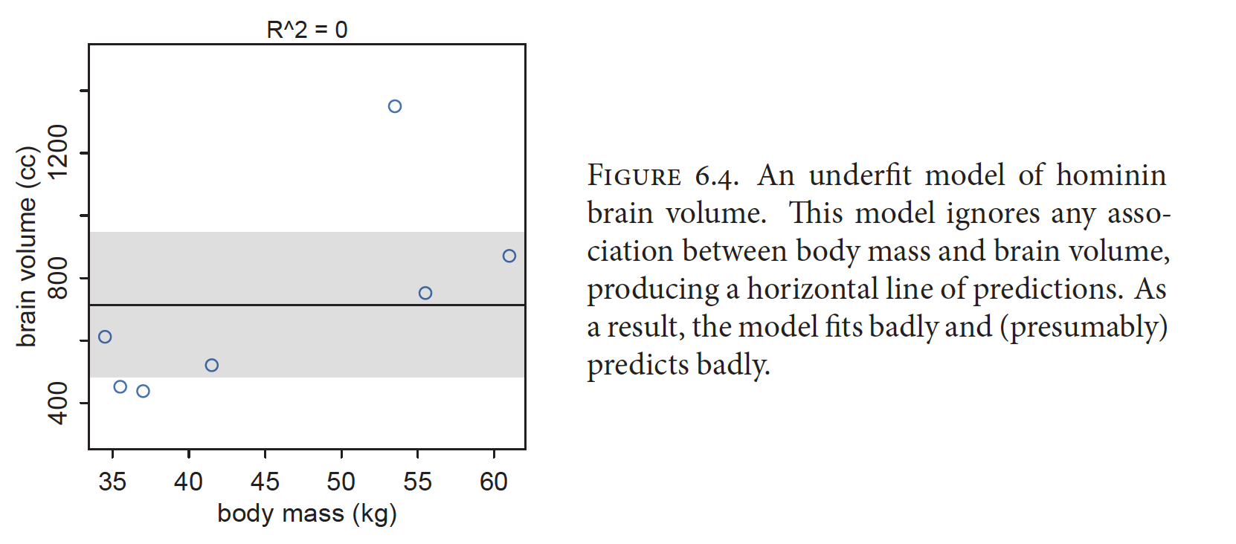
The Problem with (Too Few) Parameters
McElreath 2016, Statistical Rethinking
Notes:
In contrast, a model with too few parameters will underfit the data
One way to think of it:
When we underfit we learn too little from the data
When we overfit we learn too much from the data
Overall, this suggests we’d like to build models that balance the dangers of overfitting and underfitting

Slide 14
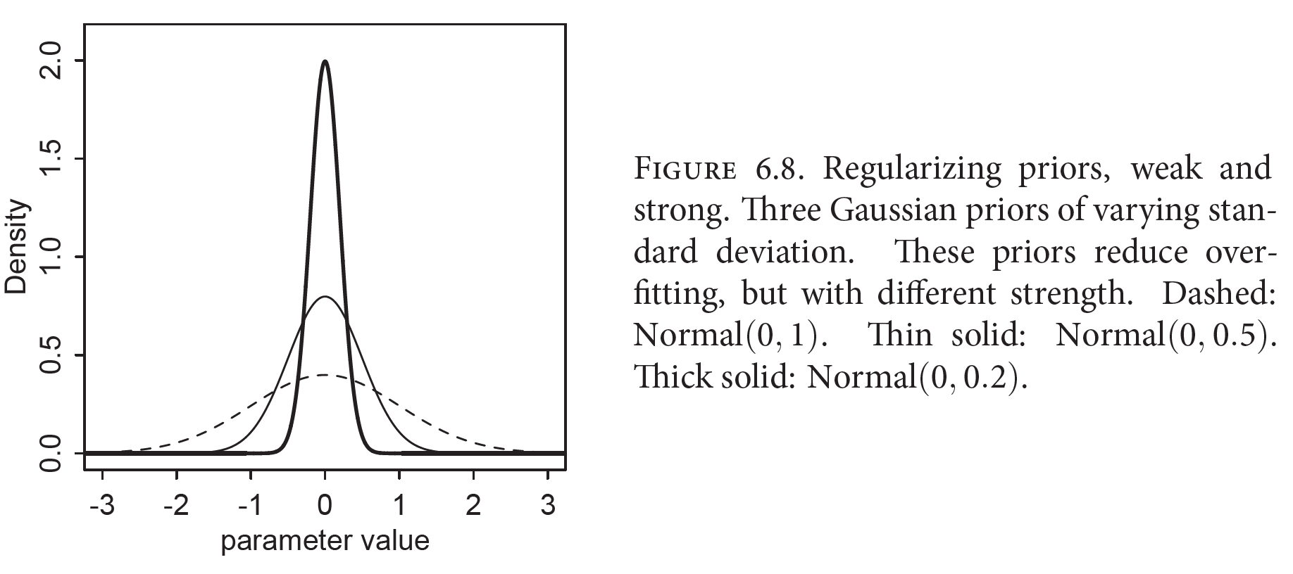
Combatting Overfitting: Regularization
A skeptical prior applied to the “slope” parameter of a linear model, which induces conservativism
McElreath 2016, Statistical Rethinking
Notes:
This conservatism is desirable since it can reduce overfitting and improve out-of-sample prediction

Slide 15
Ridge and Lasso Regression
Ridge regression is a linear modeling strategy with penalized slope coefficient estimates
Consequently, slope parameter estimates are regularized
Lasso regression is a linear modeling strategy with penalized slope coefficient estimates in which some coefficients are set to zero
Consequently, slope parameter estimates are regularized and some are selected in or out of the model
A form of variable selection (i.e., choosing variables to use in model construction and interpretation)

Slide 16
Combatting Overfitting: Information Criterion
Hirotugu Akaike
Akaike’s Information Criterion (AIC)
Notes:
https://www.google.com/logos/doodles/2017/hirotugu-akaikes-90th-birthday-5767291382792192.3-2x.png

Slide 17
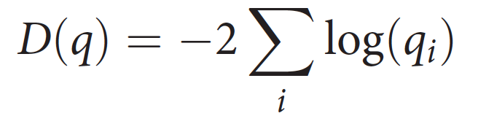
Model Deviance
Read mathematically: the summation of the log likelihood values for each case in the data, multiplied by -2
Provides an approximation of divergence
And therefore serves as an assessment of relative model fit
Notes:
However, in-sample deviance will still decline with increasing model complexity (just like R^2 values)

Slide 18
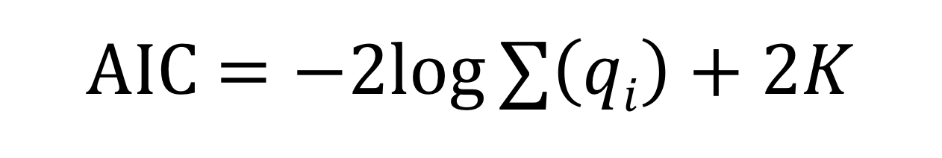
Akaike’s Information Criterion (AIC)
An estimate of out-of-sample deviance, and therefore a measure of predictive accuracy
Lower AIC scores are better
Models can only be compared relative to one another, and must be fit to the same data
AIC $=−2log∑\left(qi\right)+2K$
Model deviance:
Assesses fit
Penalization for parameters:
Controls complexity
Notes:
K = the number of parameters in the model

Slide 19
Combatting Overfitting: Information Criterion
Akaike’s Information Criterion (AIC)
Deviance defined at parameter MAP values
Deviance Information Criterion (DIC)
Deviance measure incorporates posterior parameter uncertainty
Widely Applicable Information Criterion (WAIC)
Considers a pointwise analog of deviance, the log-pointwise predictive-density
Notes:
Crucial point: ALL of these are estimates of out-of-sample deviance, which is the target we want in judging models

Slide 20

Information Criterion in Practice
Eskew et al. 2012, Conservation Biology

Slide 21
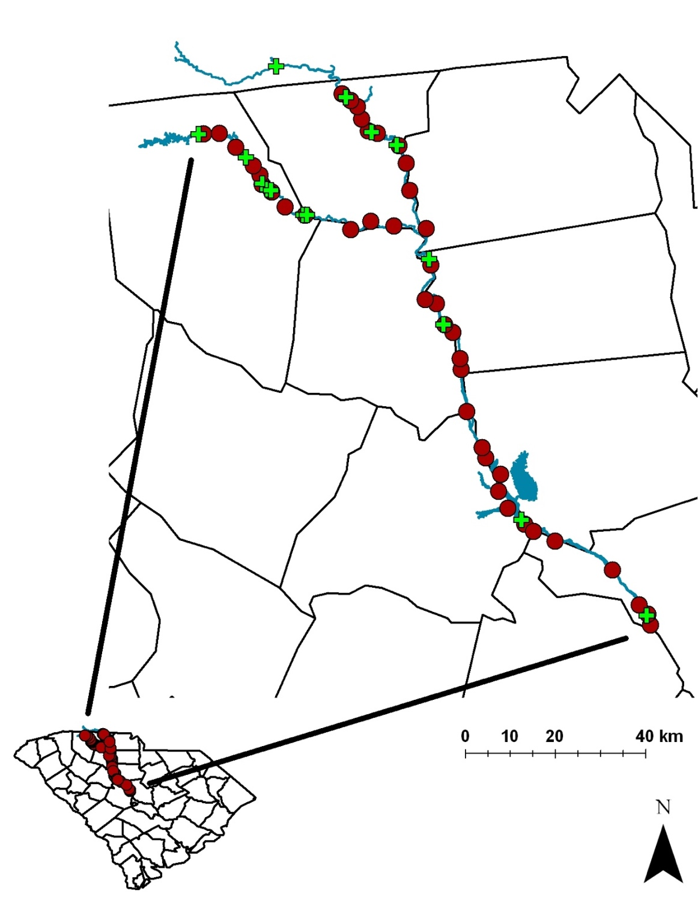

Eskew et al. 2012, Conservation Biology
Notes:
42 study sites, 16 dams

Slide 22
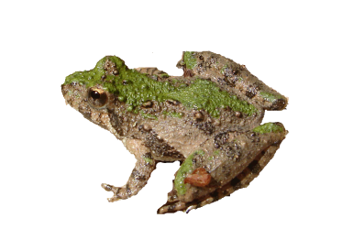
Information Criterion in Practice
Model | -2log_{e}L | No. Parameters | AIC_{c} | ΔAIC_{c} | w
Ψ(DownFromDam), p(.) | 141.43 | 3 | 148.06 | 0 | 0.4277
Ψ(DownFromDam), p(t) | 134.87 | 6 | 149.27 | 1.21 | 0.2336
Ψ(DownFromDam and Urban), p(.) | 140.24 | 4 | 149.32 | 1.26 | 0.2278
Ψ(DownFromDam and Urban), p(t) | 133.66 | 7 | 150.95 | 2.89 | 0.1008
Ψ(.), p(.) | 153.95 | 2 | 158.26 | 10.20 | 0.0026
Ψ(UpFromDam), p(.) | 151.93 | 3 | 158.56 | 10.50 | 0.0022
Ψ(.), p(t) | 147.45 | 5 | 159.12 | 11.06 | 0.0017
Ψ(UpFromDam), p(t) | 145.43 | 6 | 159.83 | 11.77 | 0.0012
Ψ(Urban), p(.) | 153.91 | 3 | 160.54 | 12.48 | 0.0008
Ψ(UpFromDam and Urban), p(.) | 151.78 | 4 | 160.86 | 12.80 | 0.0007
Ψ(Urban), p(t) | 147.41 | 6 | 161.81 | 13.75 | 0.0004
Ψ(UpFromDam and Urban), p(t) | 145.28 | 7 | 162.57 | 14.51 | 0.0003
Eskew et al. 2012, Conservation Biology
Notes:
“Akaike weights are analogous to posterior probabilities of models, conditional on expected future data.” – McElreath 2016, pg. 199
Important to remember: information theoretic approaches are relative, only find best model, not good model

Slide 23
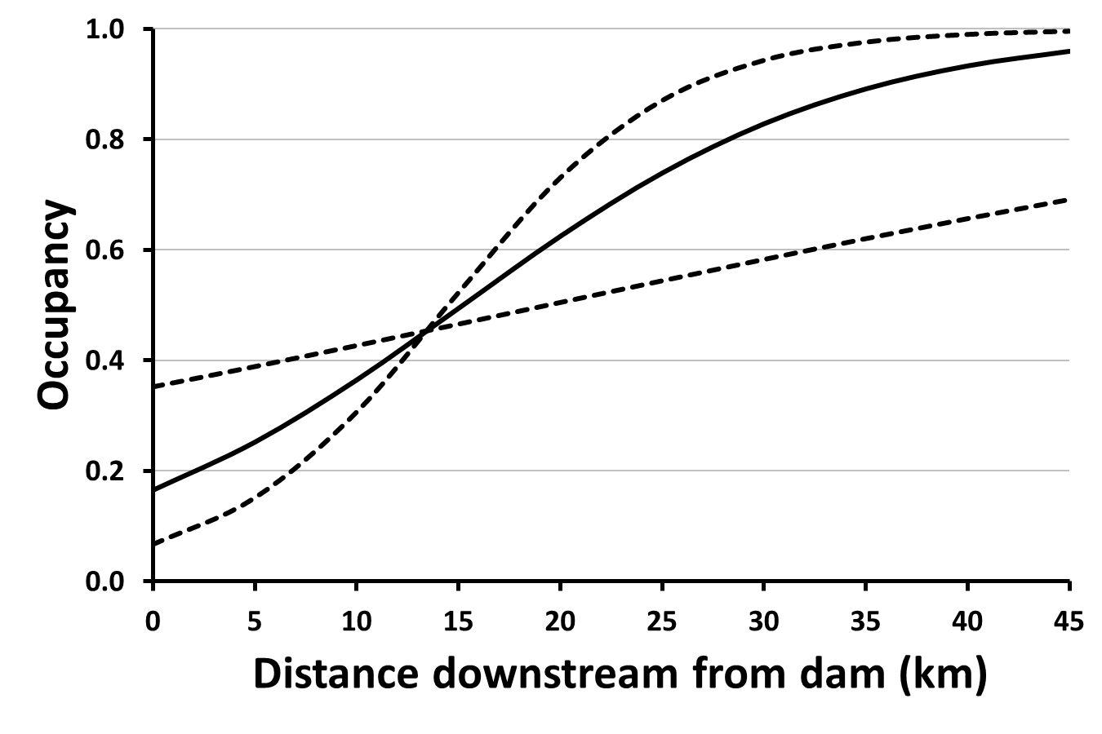
Information Criterion in Practice
Northern Cricket Frogs
Eskew et al. 2012, Conservation Biology

Slide 24
(Mis)uses of Information Criterion
Stepwise selection uses addition/removal of predictor variables from the model and repeated model selection to find the “best” model
Can result in biased parameter estimation, inconsistent model selection, etc.
All subsets selection compares a full (i.e., “global”) model containing all predictor variables of interest and all potential subsets of that model
“Use of all subsets regression is a flag that an unthinking approach has been employed.” - Anderson and Burnham 2002
Anderson and Burnham 2002, The Journal of Wildlife Management; Whittingham et al. 2006, Journal of Animal Ecology

Slide 25
Consider the Curse of Tippecanoe
William Henry Harrison
Notes:
The curse of Tippecanoe illustrates that surprising patterns can be found in many datasets
“Given enough time and data, a pattern like this can be found for almost any body of data. But without any compelling reason to believe this pattern is meaningful, it is hardly compelling that such patterns exist.” – McElreath 2016
Stepwise selection and all subsets selection can make it relatively easy to be led astray by such patterns that are not founded in biology
“The biology and underlying science should drive the hypotheses and modeling” – Anderson and Burnham 2002
https://upload.wikimedia.org/wikipedia/commons/c/c5/William_Henry_Harrison_daguerreotype_edit.jpg

Slide 26
Better Approaches
Model comparison and multimodel inference using a well-considered set of a priori models
In practice, many don’t use this approach to evaluate different hypotheses but rather to conduct an informal form of variable selection
Inference based on one well-considered full model
Most effective with larger amounts of data and can derive particular benefit from regularization
Notes:
People often do a mix of model selection and variable selection when using AIC
Dynamic Ecology post: AIC is appealing because it 1) reduces our thinking to one dimension and 2) ranks models
Comment on Dynamic Ecology post: "I suspect AIC is used because (a) it was new and sexy, and (b) it gives simple answers that don’t require too much thought. It means we can chuck lots of variables into a big black box, shake it around, and get something out of it. If we want to look really cool we can use model averaging! That’s so much easier than fitting the full model and looking at the actual model (i.e. the coefficients)."
“Our goal is to tease apart the contributions of many processes, all of which we believe are affecting our study system to some degree. If our scientific question is (something like) “How important is this factor, in an absolute sense or relative to other factors?”, not “Which of these factors are actually doing anything at all in my system?”, why are we working so hard to fit many models of which only one (the full model) incorporates all of the factors? If we do not have particular, a priori discrete hypotheses (such as “A influences the outcome but B does not”) about our system (and a multifactorial approach would suggest that we should not), why does so much of our data-analytic effort go into various ways to test between, or combine and reconcile, multiple discrete models?” – Ben Bolker

Slide 27
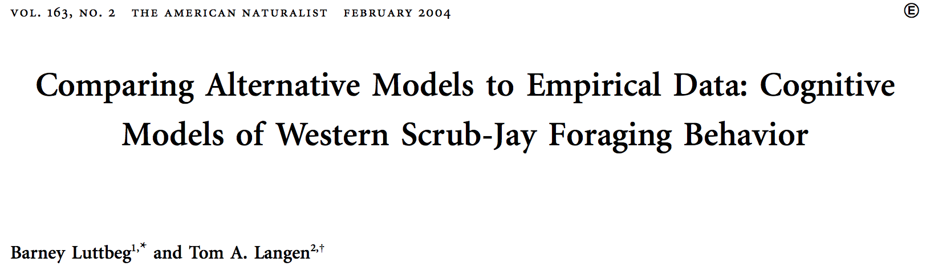
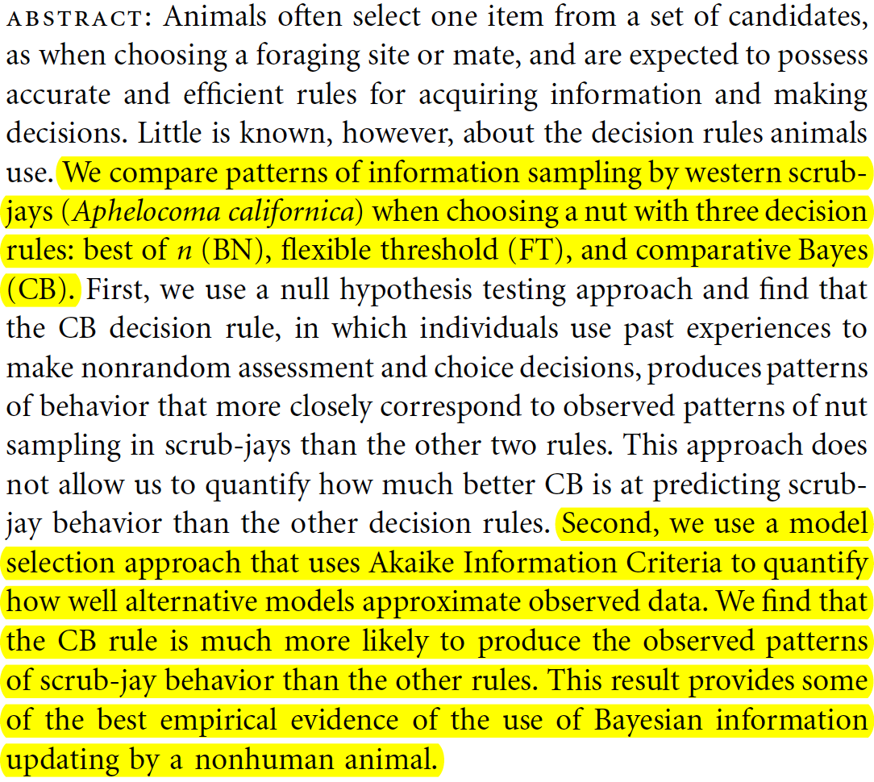

Slide 28
Final Thoughts
Carefully interpret parameter estimates within and across your models (if you use multiple models)
Use information theoretic approaches to compare models that truly represent different hypotheses about the system
Trust the (scientific) process

Slide 29
“The challenge is to begin with better science questions.” - Anderson and Burnham 2002 “As always, statistics is no substitute for science.” - McElreath 2016
Notes:
Statisticians are often the most skeptical about the inferential power of statistics

